Slide 1

Bitcoin sentimental analysis
MSA 2020 Phase 2 (Data science) business case
Michael Pham
tpha585@aucklanduni.ac.nz

Slide 2







A quick self introduction
Notes:
First and foremost, I would like to do a quick self introduction:
- I am a Final year Computer System Engineering student
- I got interested in Machine learning recently this year after working on a couple of projects related to the topic
- A little bit of insight inside of what I do outside of studying. I love the game of basketball, I’m also a gamer and I like to do research on investing.

Slide 3


Business Problem
Notes:
So, Bitcoin is digital currency that has taken a huge attention from the public by being a fast-growing asset.
Because of this, many Private Investors are interested in what the sentimental values surrounding bitcoin is to make a more informed investment.
By using the comments/discussions on the Bitcoin sub-Reddit, I can find out if Bitcoin is positively perceived by the public.

Slide 4
How I tackle the problem
Retrieve, Preprocess and Explore the dataset
Sentiment Analysis
Using prebuilt packages(Vader, TextBlob)
Using my trained model
Conclusion
Notes:
The way I tackle this problem consists of 2 main steps:
Data Processing, which includes retrieving the dataset, preprocessing and cleaning the dataset and exploring the dataset.
Next is the Sentiment Analysis in which I will analyze the dataset using prebuilt models and my own trained model.
After the analysis, I will make a conclusion

Slide 5
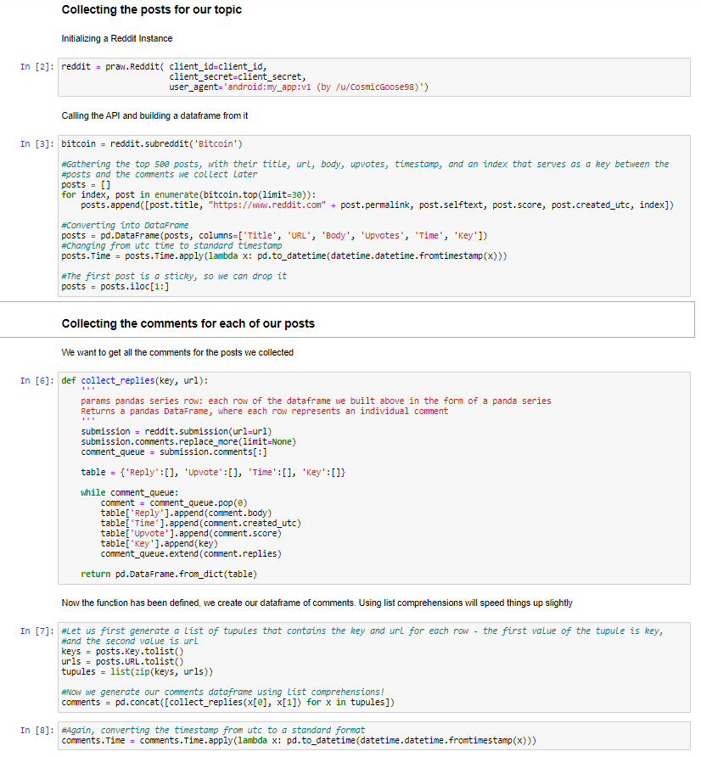
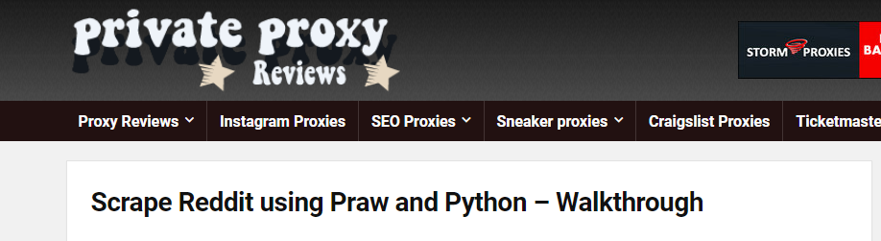
Retrieve, Preprocess and Explore
Retrieve data using the provided Reddit API
call functions
Notes:
The very first step is to retrieve the dataset,
to do this I have use the Reddit API script provided by the MSA team, which uses the Praw package to scrape Reddit comments.

Slide 6
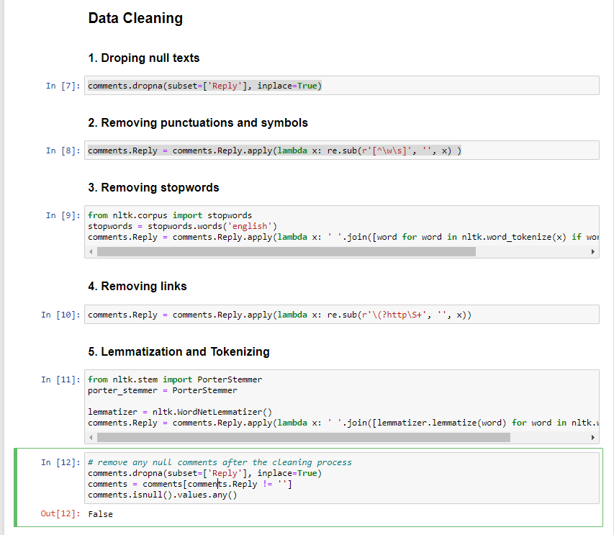
Retrieve, Preprocess and Explore
Notes:
After the dataset has been retrieved, I used some simple cleaning methods such as dropping the null comments,
Removing and punctuations and symbols
Removing stopwords to make the dataset easier to analyze
Removing Link addresses as they also don’t provide any sentiment values
The next step is lemmatization, which is more preferred than stemming as it is better than work reduction
Finally I remove any null comments again.

Slide 7
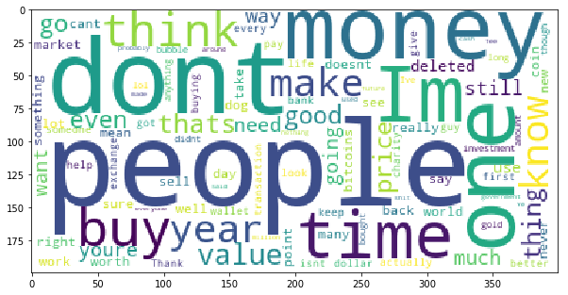

Retrieve, Preprocess and Explore
Wordcloud
Bigrams
Notes:
For the exploration process I used 2 methods. The first is the word cloud showing 100 most used words, The second is Bigrams of the top 20 bigrams that occurred at least 20 times.
The word cloud shows that the majority of most frequently used words are neutral in nature. However, there seems to be words that have positive sentiment associated to them rather than negative, words such as 'good', 'well', 'value'. This is an important observation as it means that there is a high chance that the overall sentiment regarding bitCoin is positive.
The top 20 bigrams did not convey much regarding the sentiment values of Bitcoin. Rather, there are a lot of bigrams that are related to the topic itself which is expected, such as ('Wall', 'Street') or ('Pineapple', 'Fund') which is a philanthropic project by an anonymous individual which gave away 5,057 bitcoins to 60 charities.

Slide 8
Sentiment Analysis
Prebuilt models:
Vader package’s SentimentIntensityAnalyzer
TextBlob package’s NaiveBayesAnalyzer
Notes:
The next section is to do the sentiment analysis:
To do this I have first used two different prebuilt models, which is the Vader package’s SentimentIntensityAnalyzer model and TextBlob package’s the NaiveBayes Analyzer.

Slide 9
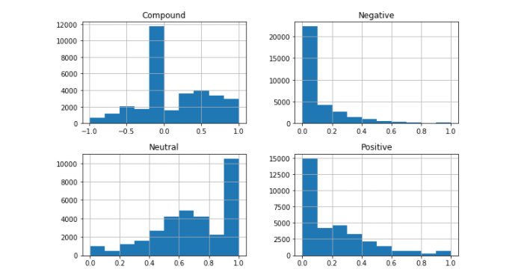
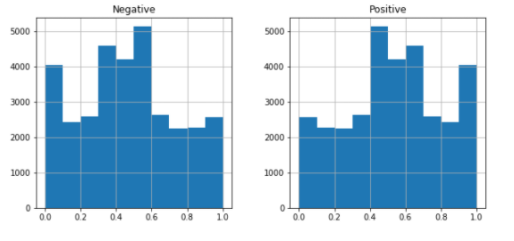
Sentiment Analysis
Observations:
1. Vader
2. Vader
Notes:
One of the obvious observation is the differences between the measurement metrics between the 2 prebuilt models. The vader model score the sentimental values in 3 measurements, positive, negative and neutral while TextBlob only score base on positive and negative.

Slide 10
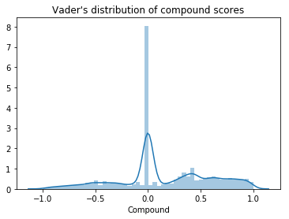
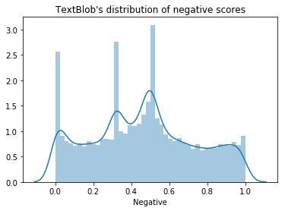
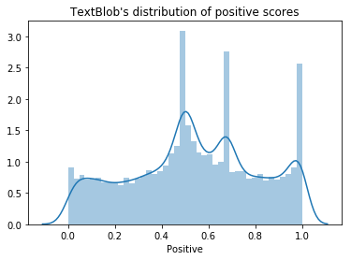
Sentiment Analysis
Observations:
1. Vader
2. Vader
Notes:
The Vader model plot of the distributed compound scores represent a bell curve which shows that the there is a large number of neutral comments. This is expected with a quick glance at the data that a lot of the comments - regarding BitCoin are information based which is nonsentimental. However, the right side of the graph is bigger than the left, which shows an overall positive sentiment regarding BitCoin.
The textBlob distribution of negative and positive scores shows that there is a higher number of comments with a positive sentiment as the positive score distribution is slightly skewed to the right.
- From these observations, we can conclude that there is a positive sentiment towards Bitcoin.

Slide 11
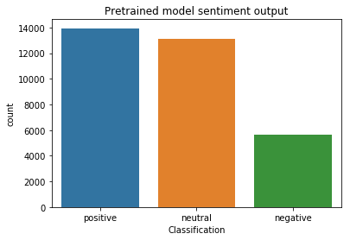
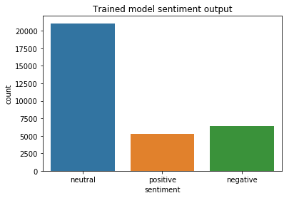
Sentiment Analysis
1. Prebuilt model (Vader)
2. Trained model
Notes:
Looking at the sentiment classification of the pretrained model, there are a lot more positive comments than negative comments
Refering to past observations of the 2 prebuilt models, Bitcoin is believe to be positively perceived by the public.
However, the model I have trained produced a significantly different result,
showing a small number of positive sentiments with just over 5200 comments and pickups a higher number of negative sentiments.

Slide 12
Conclusion
1. Prebuilt model (Vader)
2. Trained model
More robust
Pickup less sentimental values from comments
Pickups more negative sentiment
Notes:
In conclusion, the prebuilt model performed a lot better compared to the trained model
and that Bitcoin is believed to be positively perceived by the public and can be a potentially good investments for Private Investors

Slide 13
Thank you for the program
End

